Slide 1

Language Translator
Shram Sadhana Bombay Trust’s
Arts, Commerce & Science College
Bambhori, Jalgaon (MS)
Names of students: Krishna Subhash Patil & Ketan Dhanraj Patil
Specialization
(BCA)
A.Y 2024-25 Term II
Department of Computer Application
Name of Guide: Ms. Swati Badhe
Department of Computer Application
Project Presentation

Slide 2
CONTENTS
Introduction
Methodology
Objectives
Detailed Design
Literature
Review
Data Analysis
& Interpretation
Conclusions
Findings
Future Scope
References

Slide 3
OU
Introduction
Web-Based Application: The Language Translator project is a web-based application designed to translate text between multiple languages using HTML, CSS, and JavaScript.
Interactive Platform: It provides users with a simple and intuitive interface to input text in one language and receive real-time translations in another.
API Integration: The system integrates API-based translation services, allowing for accurate and dynamic language conversion.
Local Storage Usage: It uses local storage for temporary data management, eliminating the need for a backend database and enhancing efficiency.
Cross-Device Compatibility: The application is responsive and works seamlessly across multiple devices and browsers, ensuring accessibility for a diverse user base.
Addressing Communication Barriers: This project aims to bridge language gaps by providing an efficient, scalable, and user-friendly translation tool.

Slide 4
Research Objectives
1
Develop a Web-Based Translator: Create a web-based application that delivers accurate and real-time language translation.
2
Design a Responsive Interface: Build a responsive and intuitive user interface compatible with various devices and browsers for seamless accessibility.
3
Optimize Data Management: Use local storage for temporary data handling, ensuring a lightweight and efficient system without a backend.
4
Enhance User Experience: Implement user-friendly features like language swapping, speech output, and copy-to-clipboard, while allowing future improvements such as speech-to-text and offline translation.

Slide 5
Methodology
The development of the Language Translator project followed a systematic approach:
Requirement Analysis: Identifying the need for an intuitive translation tool and defining the system's functional and non-functional requirements.
Feasibility Study: Evaluating technical, operational, and time feasibility to ensure the project could be successfully implemented.
System Design: Creating use case, sequence, and data flow diagrams to outline system workflows and interactions.
Implementation: Developing the system using HTML, CSS, and JavaScript, and integrating external APIs for real-time translations.
Testing: Performing unit testing, integration testing, and user acceptance testing (UAT) to ensure functionality, accuracy, and usability.
Deployment: Hosting the application on GitHub Pages for easy access and public availability.

Slide 6
Literature Review
Flanagan, D. (2020): JavaScript: The Definitive Guide – Helped with DOM manipulation, event handling, and asynchronous operations, which were crucial for implementing real-time translations.
Robson, E., & Freeman, E. (2014): Head First HTML and CSS – Guided the development of a user-friendly and responsive interface with effective styling and cross-device compatibility.
Kogent Learning Solutions Inc. (2011): HTML5 Black Book – Provided insights into client-side scripting, including the use of local storage for temporary data handling.
Powell, T. (2017): HTML & CSS: The Complete Reference – Assisted in refining CSS styling and media queries for better responsiveness and layout design.

Slide 7
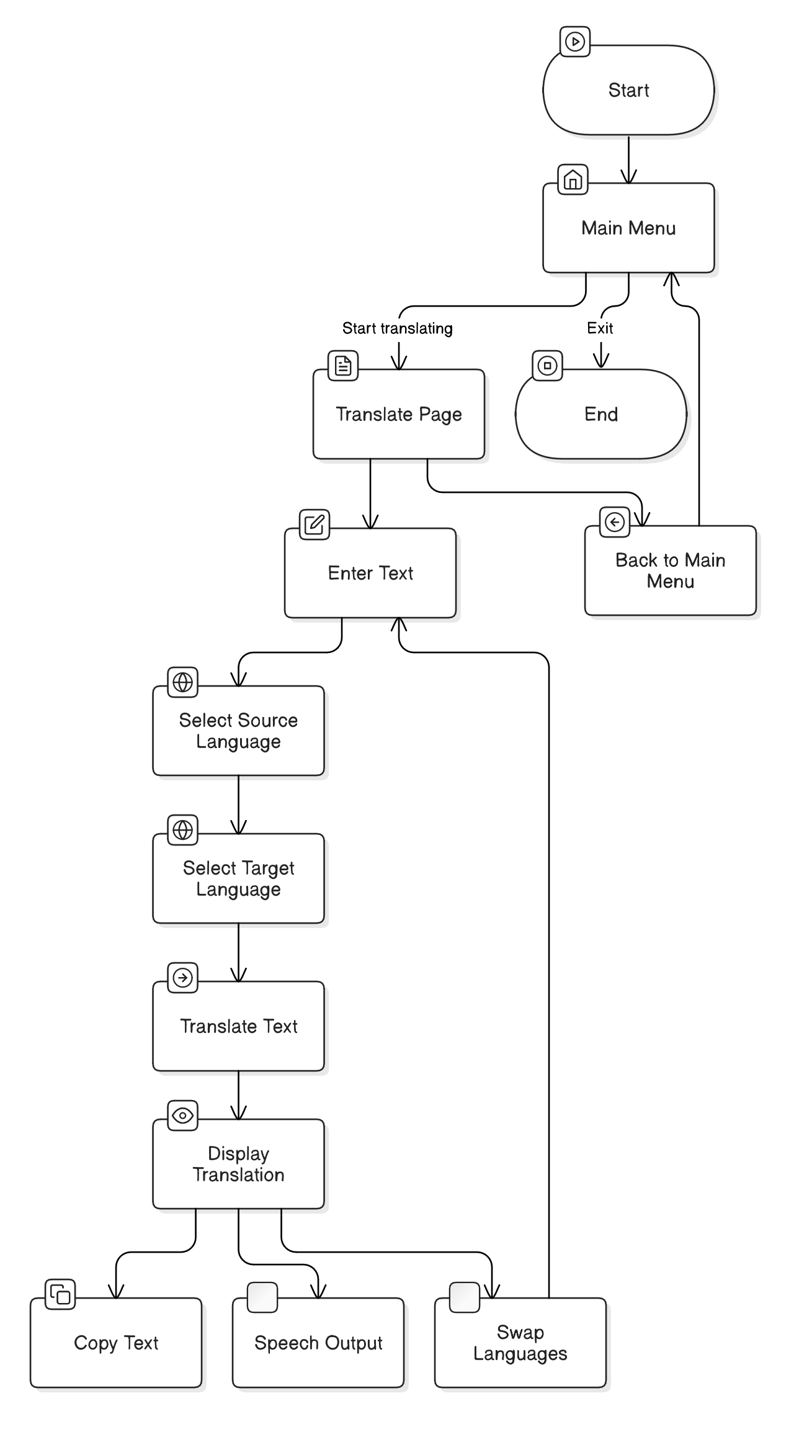
Detailed Design
Activity diagram: Describes the workflow of the Language Translator’s system and its activities.

Slide 8
Data Analysis & Interpretation
Data collected during the testing phase was analyzed to ensure system accuracy and performance.
Performance Metrics: Verified real-time translation speed and efficient page load times across devices.
User Feedback: Identified areas for improvement, including responsive design and button interactivity.
Error Handling: Addressed minor issues like CSS inconsistencies and improved UI responsiveness based on test results.
The analysis confirmed that the system is accurate, fast, and user-friendly under different conditions.

Slide 9
Findings
.
The Language Translator project successfully achieved its intended objectives. Key findings include:
The application provides accurate real-time translation for multiple languages.
Responsive design ensures smooth performance across devices and screen sizes.
Local storage allows temporary data retention without requiring backend infrastructure.
Users found the system intuitive, with minor adjustments made to improve UI interactivity.

Slide 10
Future Scope
.
Several enhancements can be incorporated to extend the capabilities of the Language Translator:
Expanded Language Support: Adding more languages and dialects.
Speech-to-Text and Text-to-Speech: Enabling voice input and output for better accessibility.
Offline Translation: Implementing local storage solutions to support translations without an internet connection.
AI-driven Contextual Accuracy: Leveraging machine learning to enhance translation precision.
User Personalization: Allowing users to save phrases and customize the UI.
Cross-Platform Optimization: Improving performance on both mobile and tablet devices.

Slide 11
Conclusion
Efficient Translation Solution: The Language Translator project showcases how HTML, CSS, and JavaScript can create an efficient and user-friendly language translation application.
Real-Time and Intuitive Interface: The system provides real-time translations through an intuitive interface, ensuring easy navigation for users.
Cross-Device Compatibility: The application is responsive and works seamlessly across various devices and browsers, enhancing accessibility.
Scalable and Future-Ready: The project meets functional requirements and offers a lightweight, scalable solution, providing a foundation for future enhancements like speech-based input and offline translation.

Slide 12
References
Flanagan, D. (2020) - JavaScript: The Definitive Guide. O'Reilly Media.
Robson, E., & Freeman, E. (2014) - Head First HTML and CSS. O'Reilly Media.
Kogent Learning Solutions Inc. (2011) - HTML5 Black Book. Dreamtech Press.
Powell, T. (2017) - HTML & CSS: The Complete Reference, Fifth Edition. McGraw Hill Education.
Mozilla Developer Network (MDN Web Docs) – https://developer.mozilla.org
MyMemory API Documentation – https://mymemory.translated.net
GitHub Pages – For hosting the Language Translator application.

Slide 13
Thank You

